Slide 1

Lecture 08: Propositional Logic
Artificial Intelligence (CS 131)

Slide 2
Knowledge-Based Agents
Image source: Russell & Norvig (2021)
We can build AI agents that act in the world based upon incoming data, supplemented by their knowledge of the world
Actions are chosen based upon KB, a knowledge-base
Incoming data (percepts) and chosen actions are also recorded to that knowledge-base

Slide 3
Using Logic for Knowledge Bases
A logic is a formal language:
Represents facts that we know about the world: each such fact is a sentence in our logical language
Allows us to generate new facts based on what we already know by performing inference
A logic has two basic components:
Syntax: defines what counts as a sentence of the language
Semantics: defines what makes a sentence true or false

Slide 4
The Wumpus World (PEAS)
Image source: Russell & Norvig (2021)
Performance:
gold = +1000; death = –1000
step = –1; use arrow = –10
Environment:
Square next to Wumpus: Smelly
Square next to Pit: Breezy
Gold squares: Glitter
Shooting Wumpus kills it (if facing it)
Shooting Wumpus uses up the only arrow
Agent can grab gold to pick it up
Actuators:
Forward, TurnLeft, TurnRight, Grab, Shoot, Climb
Sensors/Percepts:
[Stench, Breeze, Glitter, Bump, Scream]

Slide 5
Exploring the Wumpus World
Initial percepts:
Agent can infer that current and adjacent squares are all empty (and OK to enter)
OK
A
OK
OK
A
: Agent

Slide 6
Exploring the Wumpus World
On moving right, the agent receives percepts:
Agent can now infer that a Pit is adjacent, although it does not know where
OK
Pit?
A
B
OK
OK
Pit?
A
: Agent
: Breeze
B

Slide 7
Exploring the Wumpus World
On moving up, the agent again receives percepts:
Agent can now infer that there must be a Pit at bottom right
OK
OK
Pit?
A
B
OK
OK
Pit!
Pit?
A
: Agent
: Breeze
B

Slide 8

Exploring the Wumpus World
Wumpus!
S
A
Finally, moving left, the agent receives:
Agent can now infer that there must be a Wumpus above current location
OK
OK
B
OK
OK
Pit!
Pit?
A
: Agent
: Breeze
: Stench
B
S

Slide 9
Inference & Logical Entailment
An inference rule tells an agent how to draw conclusions based upon what they already know
Valid rules encode a semantic relationship between what we infer and and what is already in our knowledge base
We say that a sentence α follows from our knowledge base, KB, or that KB entails α:
For example:

Slide 10
Semantic Models
A formal semantics defines truth and entailment in terms of a logical model
Circumstances under which a sentence is true or false
Model m is a model of sentence α if α is true in m
M(α) = set of all models of α
KB entails α whenever all models of KB are also models of α
M(α)
M(KB)

Slide 11
Models for the Wumpus World
The agent starts at bottom left, sensing nothing adjacent to it:
On moving right, the agent senses a breeze:
Based on this sequence of percepts, there exist a total of 8 possible models representing the presence or absence of pits in each of the 3 adjacent squares
?
?
B
?
A
OK
OK
A
: Agent
: Breeze
B

Slide 12
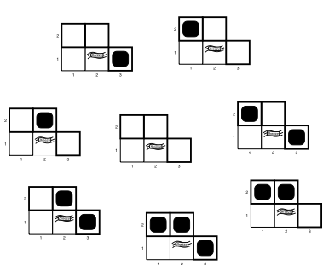
Models for the Wumpus World
Image source: Russell & Norvig (2021)
With 8 basic models, our knowledge base will consist of all of those that are consistent with our observation of the breeze, given the rules defining the Wumpus World environment

Slide 13
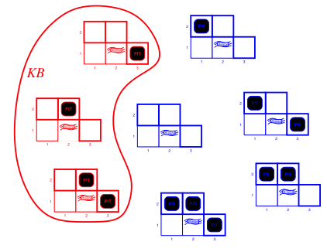
Models for the Wumpus World
With 8 basic models, our knowledge base will consist of all of those that are consistent with our observation of the breeze, given the rules defining the Wumpus World environment

Slide 14
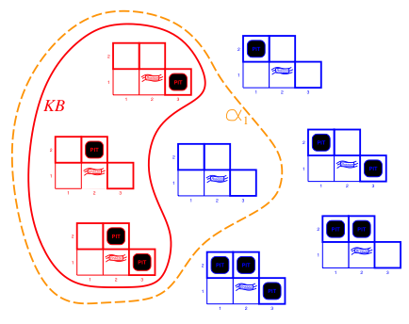
Models for the Wumpus World
α₁ = “[1,2] is safe” is entailed by our knowledge base, due to the containment relationship between the models

Slide 15
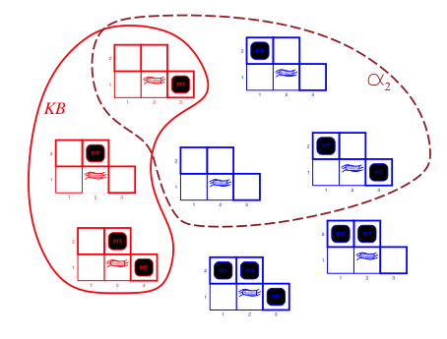
Models for the Wumpus World
α₂ = “[2,2] is safe” is not entailed, however, since there are conditions in which KB is true, but α₂ is still false

Slide 16
Syntax of Propositional Logic (PL)
A basic formal language for representing simple statements of fact (propositions)
A set of logical connectives and a simple recursive syntax (grammar) for their combination into sentences
Basic proposition symbols, P₁, P₂, …, are sentences
If S is a sentence, ¬S is a sentence (negation)
If S₁ and S₂ are sentences, S₁ ∧ S₂ is a sentence (conjunction)
If S₁ and S₂ are sentences, S₁ ∨ S₂ is a sentence (disjunction)
If S₁ and S₂ are sentences, S₁ ⇒ S₂ is a sentence (implication)
If S₁ and S₂ are sentences, S₁ ⇔ S₂ is a sentence (biconditional)

Slide 17
Semantics of Propositional Logic (PL)
A PL model m is an assignment of true/false values to whatever basic propositional symbols exist
P₁ = True, P₂ = False, P₃ = True, etc.
For n propositional symbols, 2^{n} such models are possible
Given an assignment to basic symbols, all more complex sentences are true/false according to semantic rules:
¬S is true iff (if and only if) S is false
S₁ ∧ S₂ is true iff S₁ is true and S₂ is true
S₁ ∨ S₂ is true iff S₁ is true or S₂ is true
S₁ ⇒ S₂ is true iff S₁ is false or S₂ is true
S₁ ⇔ S₂ is true iff S₁ ⇒ S₂ is true and S₂ ⇒ S₁ is true

Slide 18
Truth Tables for PL Semantics
P | Q | ¬P | P ∧ Q | P ∨ Q | P ⇒ Q | P ⇔ Q
T | T | F | T | T | T | T
T | F | F | F | T | F | F
F | T | T | F | T | T | F
F | F | T | F | F | T | T
The basic semantic rules of PL correspond to a simple set of truth tables, each of which gives the result of applying one connective to one or more propositional symbols
Each connective is defined by its truth function: takes one or more truth values as input and outputs another truth value

Slide 19
Logic in the Wumpus World
We can use PL to express the situation of the agent:
Let P_{i,j} be true if there is a pit in location [i, j]
Let B_{i,j} be true if there is a breeze in location [i, j]
The relevant KB is:
PL can also express Wumpus World rules like “Pits cause breezes in adjacent squares”:
?
?
B
?
A
OK
OK
A
: Agent
: Breeze
B

Slide 20
Truth-Functional Analysis (01)
Based on the basic truth tables, we can assign a semantic value to any complex PL sentence, recursively

Slide 21
Truth-Functional Analysis (02)
Based on the basic truth tables, we can assign a semantic value to any complex PL sentence, recursively

Slide 22
Truth-Functional Analysis (03)
Based on the basic truth tables, we can assign a semantic value to any complex PL sentence, recursively

Slide 23
Truth-Functional Analysis (04)
Based on the basic truth tables, we can assign a semantic value to any complex PL sentence, recursively

Slide 24
Truth-Functional Analysis (05)
Based on the basic truth tables, we can assign a semantic value to any complex PL sentence, recursively

Slide 25
Truth-Functional Analysis (06)
Based on the basic truth tables, we can assign a semantic value to any complex PL sentence, recursively

Slide 26
Valid and Satisfiable Sentences
An expression like this is valid: true in any possible model that assigns truth values to propositional symbols
In addition, a sentence like this is satisfiable, i.e. there exists some model that makes it true

Slide 27
Valid and Satisfiable Sentences
Key relationships to remember:
α is satisfiable
¬ α is not valid
α is not satisfiable
¬ α is valid

